Slide 1

System Design Project

Slide 2
Names:
Khaled Essam Abdelnaaem Abdellatif
Fares Mohamed Yehia Zakaria
Karim antar mohamed
Mohamed Zoher mohamed ibrahim
Mohamed Elsayed Ahmed Mohamed.
Osama mohammed abdelshafy
Ahmed samir Mohamed
Ahmed Samir abdelazim

Slide 3
Table Of Contents
1
2
3
Analyzing System Needs
Identifying the Problem
Determining Information Requirements

Slide 4

In many clinics, patient appointments are mismanaged due to manual processes, resulting in mixed-up schedules, long wait times, and patient no-shows. There’s a lack of real-time communication between doctors, receptionists, and patients. This system aims to automate and optimize the booking process by providing appointment scheduling, reminders, and visibility into doctor availability.
1
Identifying the Problem

Slide 5


2
Determining Information Requirements
2.1 The interview
2.2 interview Insights

Slide 6

2.1 The interview
Question 1 for a doctor:
What challenges do you face in managing patient appointments ?
Answer: Sometimes appointments get mixed up
Question 2 for a receptionist:
What challenges do you face in booking appointments and registering patients?
Answer: Some patients book and never show up
Question 3 for a Patient:
What problems do you face when visiting the hospital?
Answer: Sometimes I wait too long. I’d love to know the doctor’s schedule

Slide 7
2.2 Interview Insights:
System Expectations (Features Needed):
Automated Appointment Scheduling with doctor availability.
Real-time Notifications/Reminders for patients.
Appointment Management for receptionists to confirm or cancel.

Slide 8
2.2 Interview Insights:
User Goals:
A clear, organized appointment schedule.
Receptionist can manage and confirm appointments.
Patient can book appointments easily online.
Patient can receive reminders/notifications for upcoming appointments.

Slide 9
2.2 Interview Insights:
Pain Points (Current Challenges):
For Doctors:
Appointment schedules often get mixed up or disorganized.
For Receptionists:
Some patients book appointments and do not show up.
Manual booking and registration process is time-consuming and error-prone.
For Patients:
Long waiting times upon arrival.
No reminders, leading to forgotten appointments.

Slide 10
3
Analyzing System Needs
3.1 Requirements
3.2 features
3.3 Required Diagrams:

Slide 11
3.1 Requirements
Patients can book appointments online.
Doctors can view upcoming appointments.
Receptionists can manage and confirm appointments.
Receptionists sends reminders to patients (via email/SMS).
Patients can view doctor availability in real-time.

Slide 12
3.2 features
Appointment Management
Schedule Management (Doctor Dashboard)
Notifications & Reminders

Slide 13
3.3 Required Diagrams

Slide 14
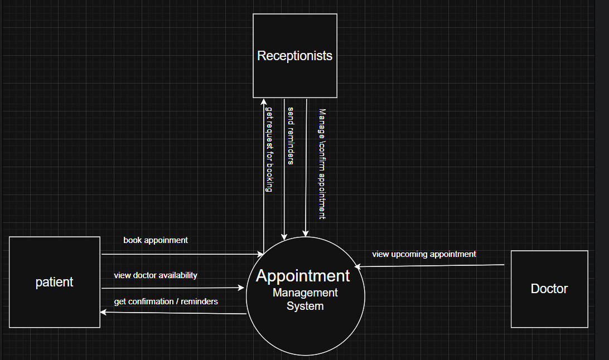
Context Flow Diagram (DFD):

Slide 15
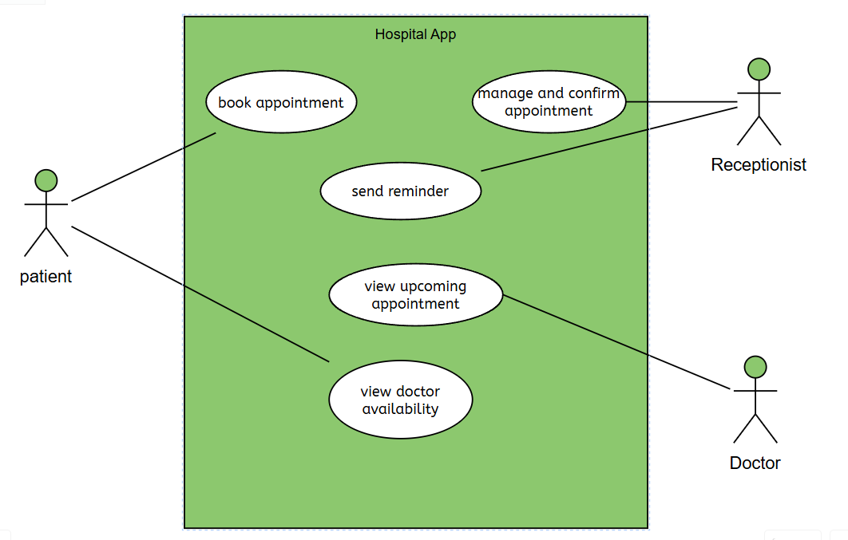
use case diagram

Slide 16
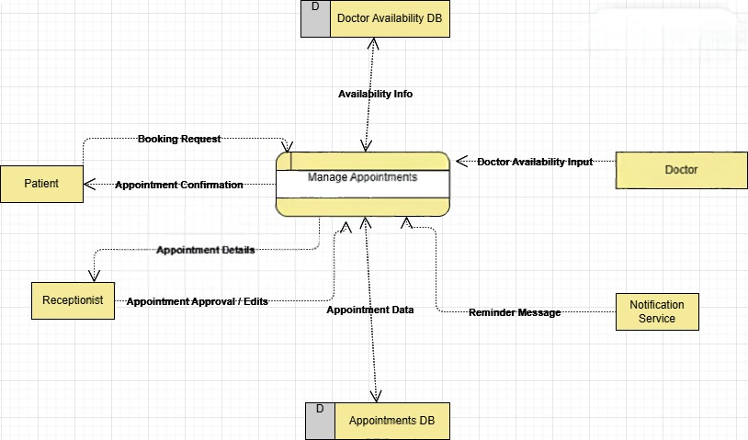
DFD 0 diagram

Slide 17
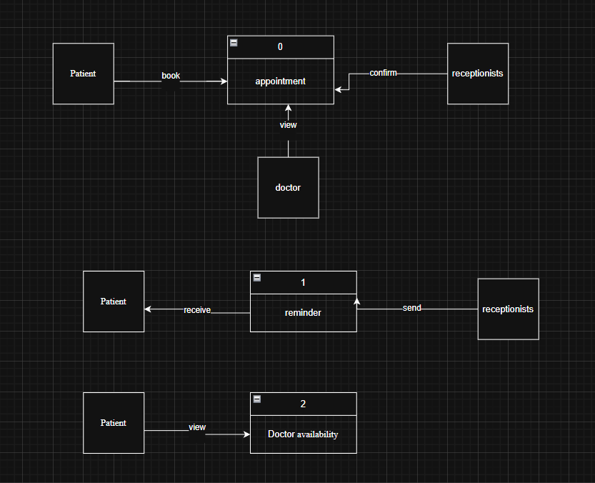
Child diagram

Slide 18
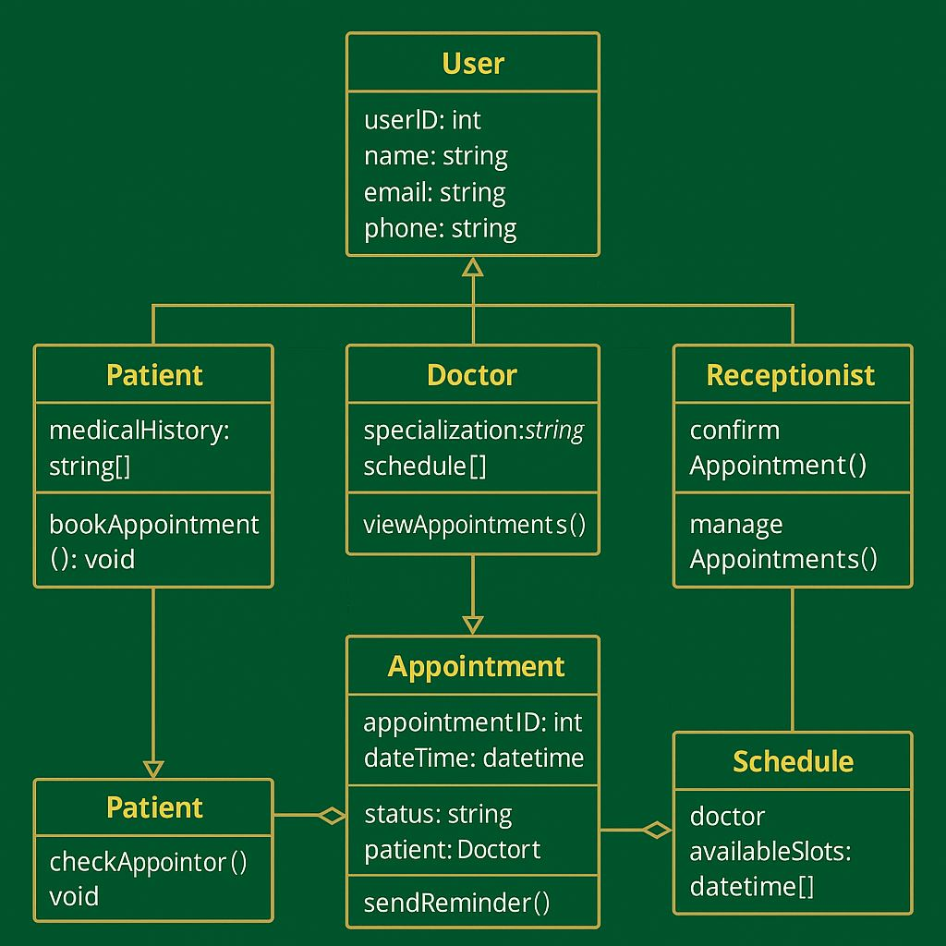
Class diagram

Slide 19
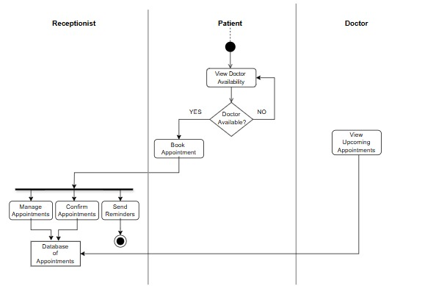
Activity Flow Diagram:

Slide 20
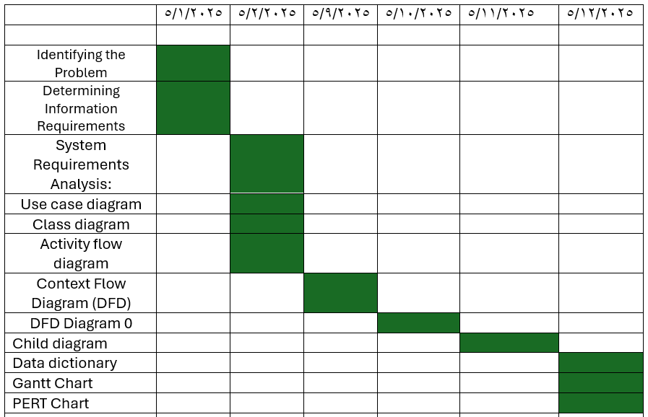
Gantt chart

Slide 21
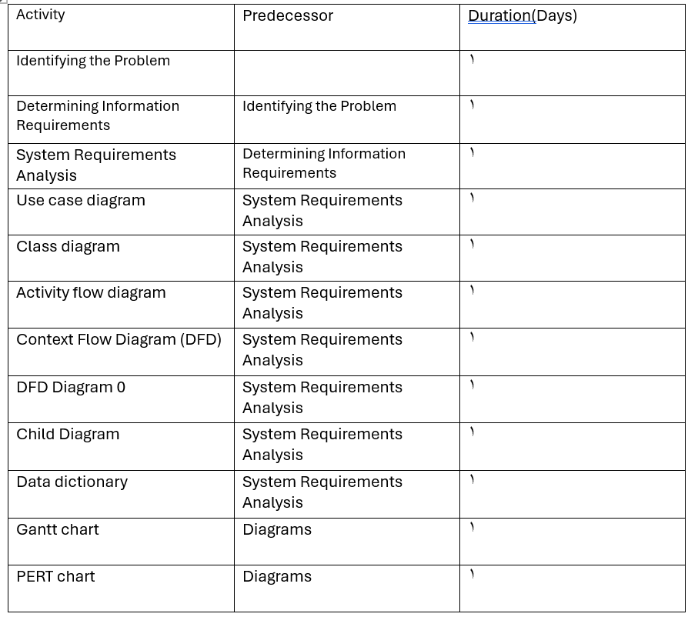
PERT chart

Slide 22
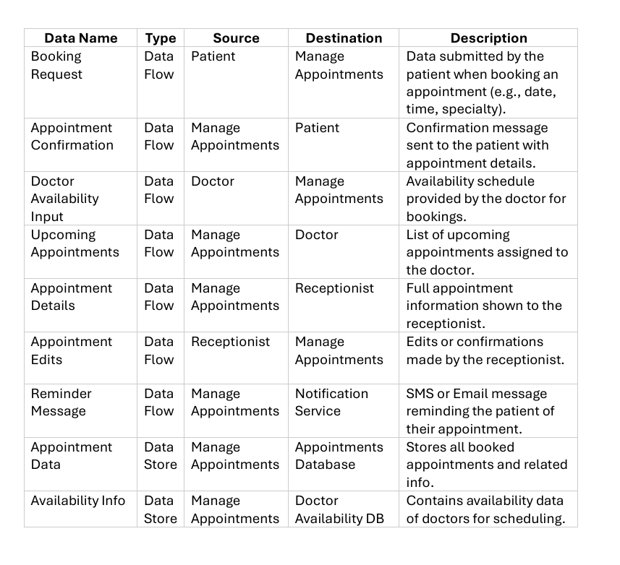
Data dictionary

